Slide 1


Slide 2

What is Machine Learning?
Machine learning allows
computers to learn and
infer from data.
2

Slide 3

Machine Learning in Our Daily Lives
Spam Filtering
3

Slide 4

Machine Learning in Our Daily Lives
Spam Filtering
Web Search
4

Slide 5

Machine Learning in Our Daily Lives
Spam Filtering
Web Search
Postal Mail Routing
5

Slide 6

Machine Learning in Our Daily Lives
Spam Filtering
Fraud Detection
Web Search
Postal Mail Routing
Vehicle Driver Assistance
Speech Recognition
Movie Recommendations
Social Networks
Web Advertisements
6

Slide 7

Types of Machine Learning
Supervised
Data points have known outcome
7

Slide 8

Types of Machine Learning
Supervised
Data points have known outcome
Data points have unknown outcome
unSupervised
8

Slide 9
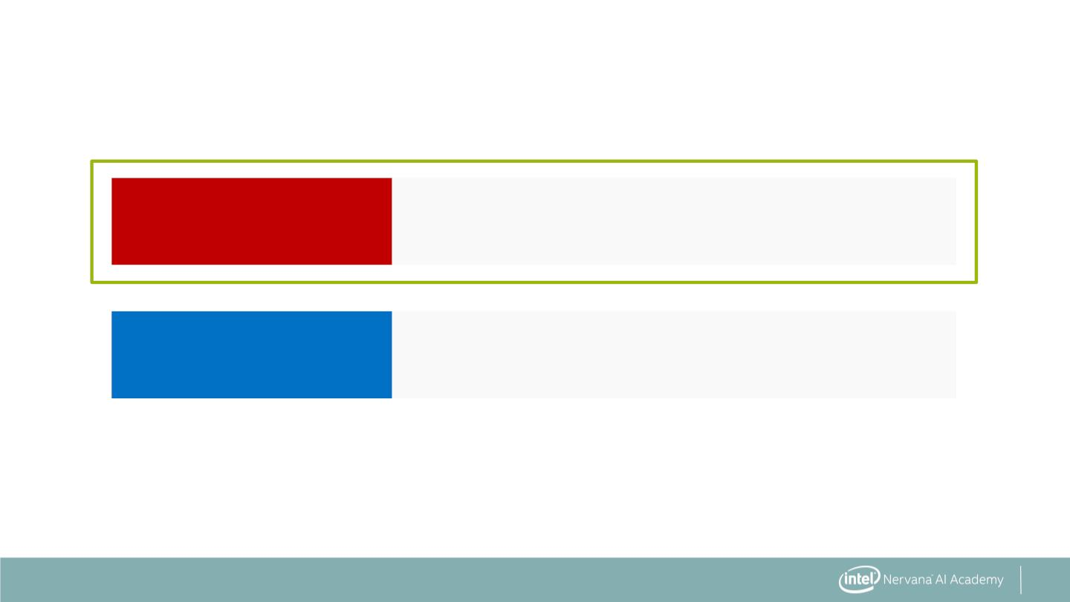
Types of Machine Learning
Supervised
Data points have known outcome
Data points have unknown outcome
unSupervised
9

Slide 10

Types of Supervised Learning
regression
Outcome is continuous (numerical)
10

Slide 11
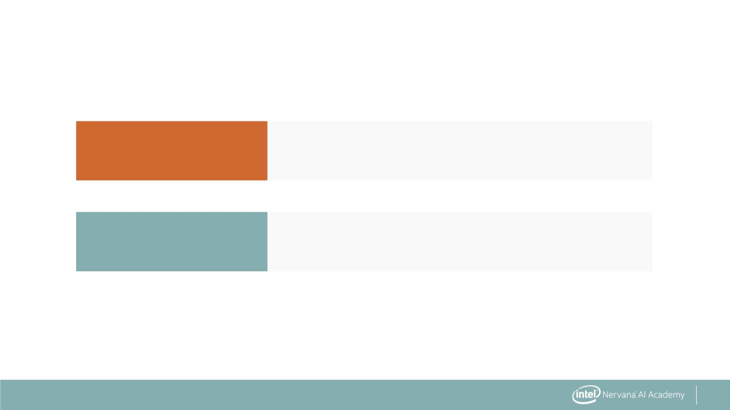
Types of Supervised Learning
regression
Outcome is continuous (numerical)
Outcome is a category
classification
11

Slide 12
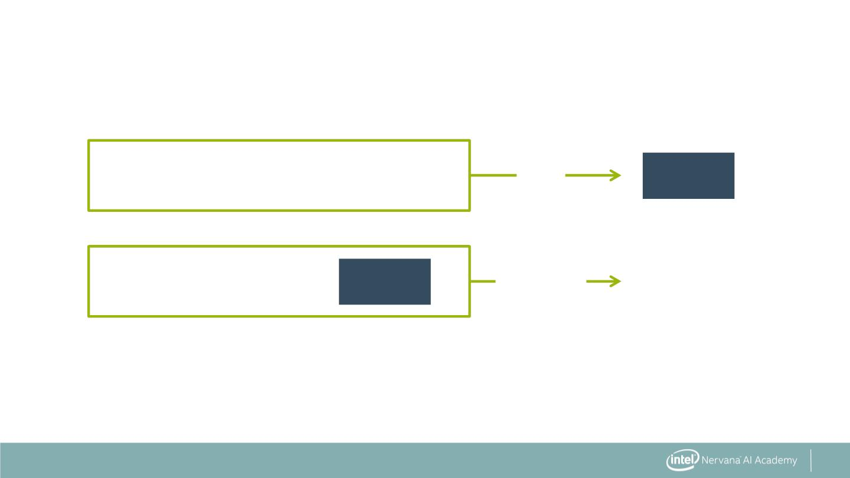
Supervised Learning Overview
Data with
answers
+
+
model
Model
Fit
Data without
answers
model
Predicted
answers
Predict
12

Slide 13
Regression: Numerical Answers
Movie data with
revenue
+
+
model
Model
Fit
Movie data
(unknown revenue)
model
Predicted
revenue
Predict
13

Slide 14
Classification: Categorical Answers
Labeled
data
+
+
model
Model
Fit
Unlabeled
data
model
Predict
Labels
14

Slide 15
Classification: Categorical Answers
Emails labeled as
spam/not spam
+
+
model
Model
Fit
Unlabeled
emails
model
Spam or
not spam
Predict
15

Slide 16

Machine Learning Vocabulary
. Target: predicted category or value of the data
(column to predict)
16

Slide 17
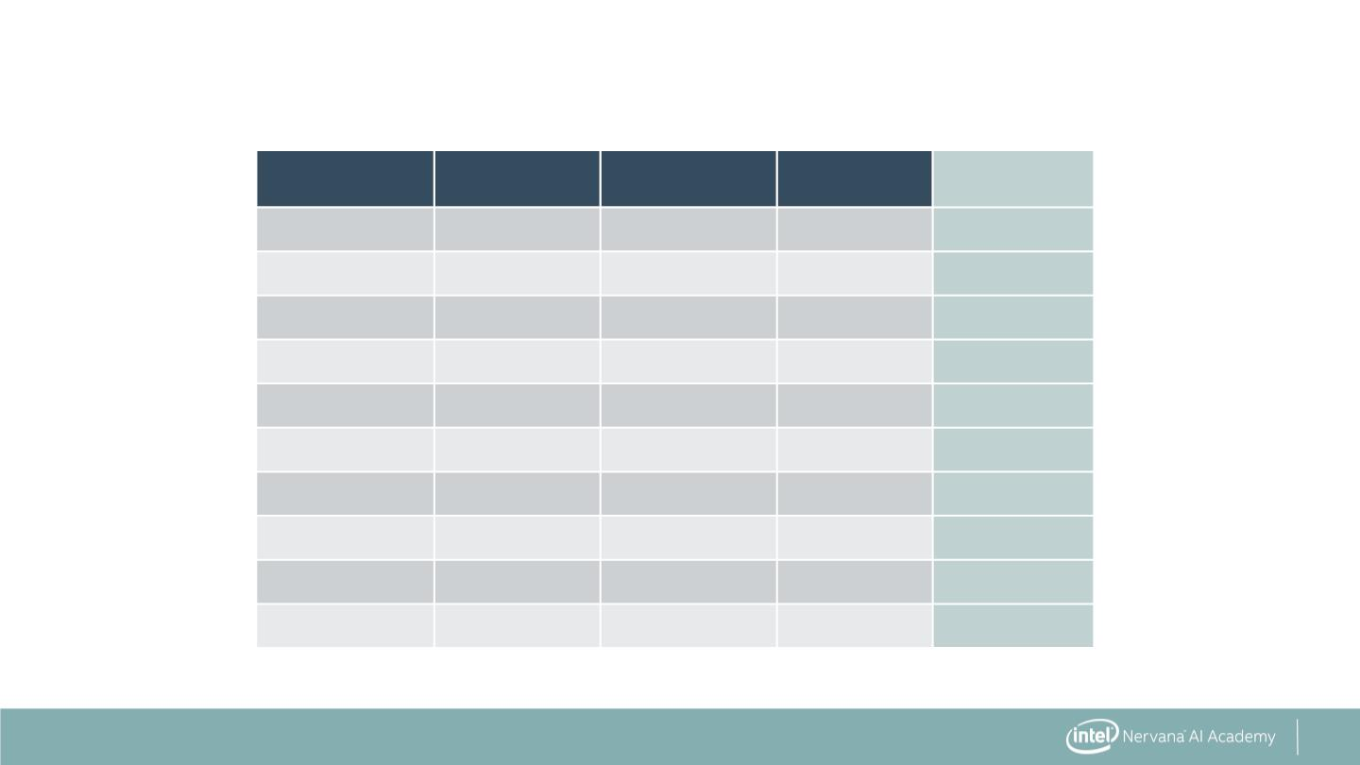
Machine Learning Vocabulary
Sepal length
Sepal width
Petal length
Petal width
Species
6.7
6.4
4.6
6.9
4.4
4.8
5.9
5.4
4.9
5.4
3.0
2.8
3.4
3.1
2.9
3.0
3.0
3.9
3.0
3.4
5.2
5.6
1.4
4.9
1.4
1.4
5.1
1.3
1.4
1.7
2.3
2.1
0.3
1.5
0.2
0.1
1.8
0.4
0.2
0.2
Virginica
Virginica
Setosa
Versicolor
Setosa
Setosa
Virginica
Setosa
Setosa
Setosa
17

Slide 18
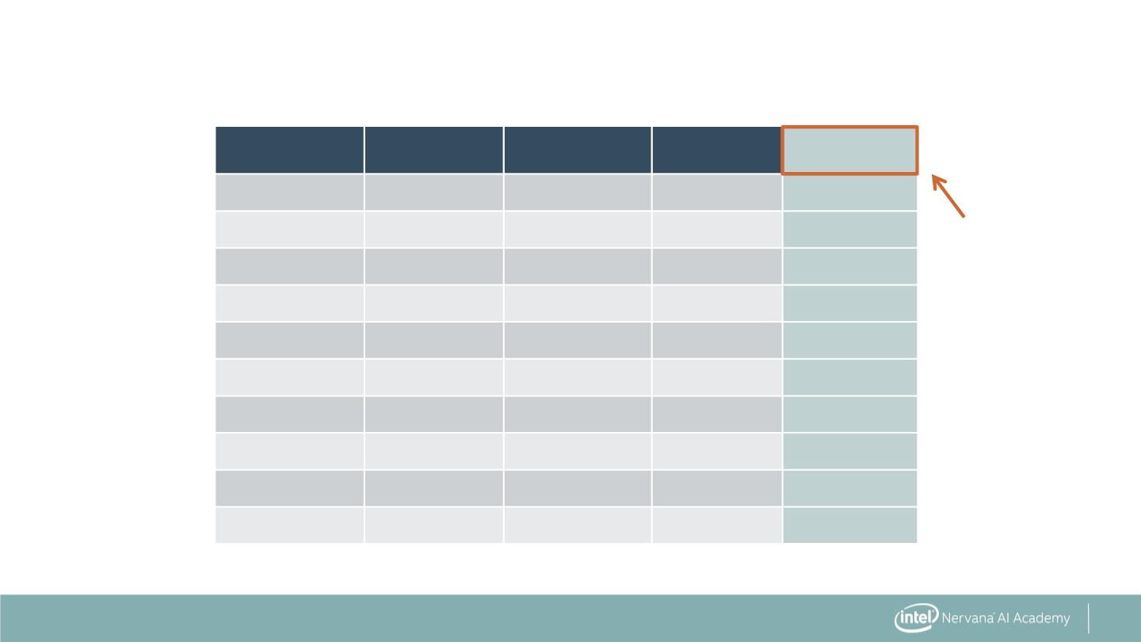
Machine Learning Vocabulary
Sepal length
Sepal width
Petal length
Petal width
Species
6.7
6.4
4.6
6.9
4.4
4.8
5.9
5.4
4.9
5.4
3.0
2.8
3.4
3.1
2.9
3.0
3.0
3.9
3.0
3.4
5.2
5.6
1.4
4.9
1.4
1.4
5.1
1.3
1.4
1.7
2.3
2.1
0.3
1.5
0.2
0.1
1.8
0.4
0.2
0.2
Virginica
Virginica
Setosa
Target
Versicolor
Setosa
Setosa
Virginica
Setosa
Setosa
Setosa
18

Slide 19
Machine Learning Vocabulary
. Target: predicted category or value of the data
(column to predict)
. Features: properties of the data used for prediction
(non-target columns)
19

Slide 20
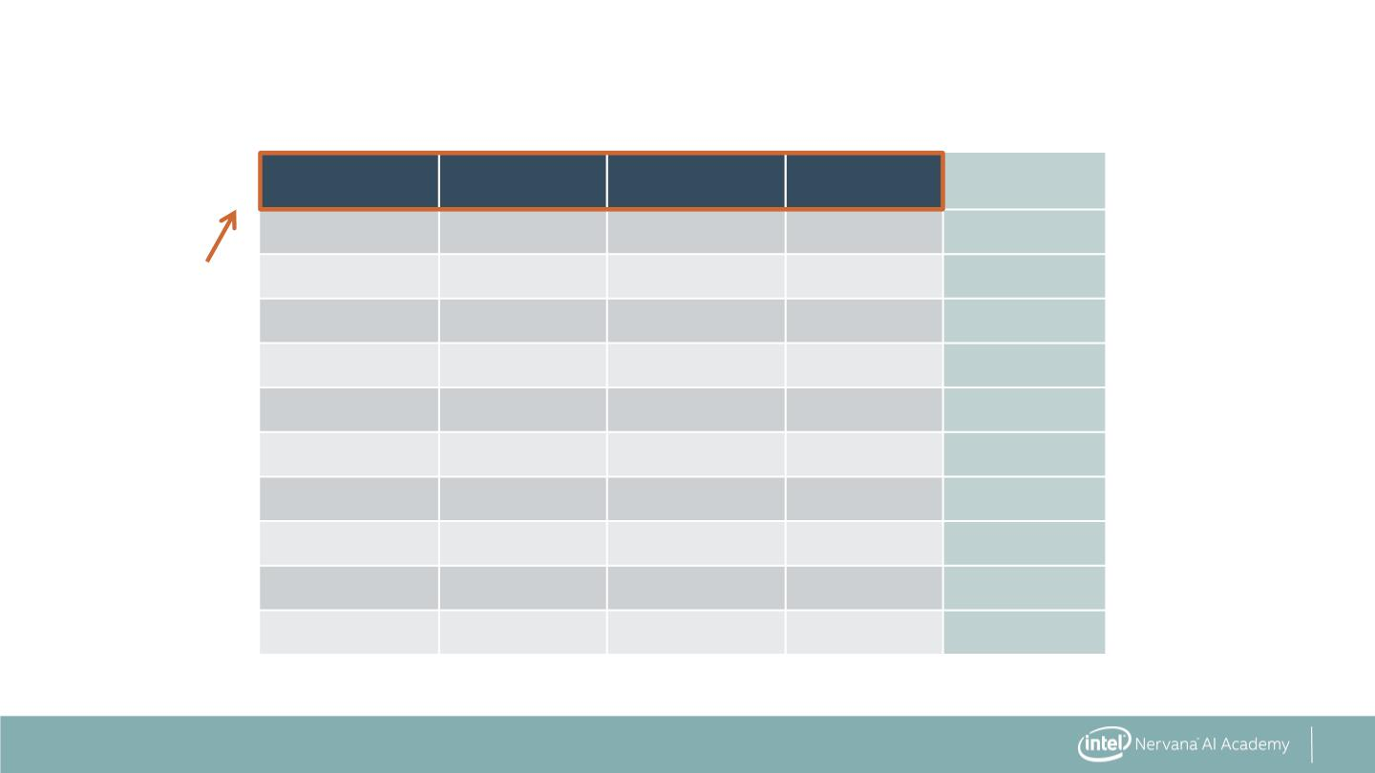
Machine Learning Vocabulary
Sepal length
Sepal width
Petal length
Petal width
Species
6.7
6.4
4.6
6.9
4.4
4.8
5.9
5.4
4.9
5.4
3.0
2.8
3.4
3.1
2.9
3.0
3.0
3.9
3.0
3.4
5.2
5.6
1.4
4.9
1.4
1.4
5.1
1.3
1.4
1.7
2.3
2.1
0.3
1.5
0.2
0.1
1.8
0.4
0.2
0.2
Virginica
Virginica
Setosa
Features
Versicolor
Setosa
Setosa
Virginica
Setosa
Setosa
Setosa
20

Slide 21
Machine Learning Vocabulary
. Target: predicted category or value of the data
(column to predict)
. Features: properties of the data used for prediction
(non-target columns)
. Example: a single data point within the data
(one row)
21

Slide 22
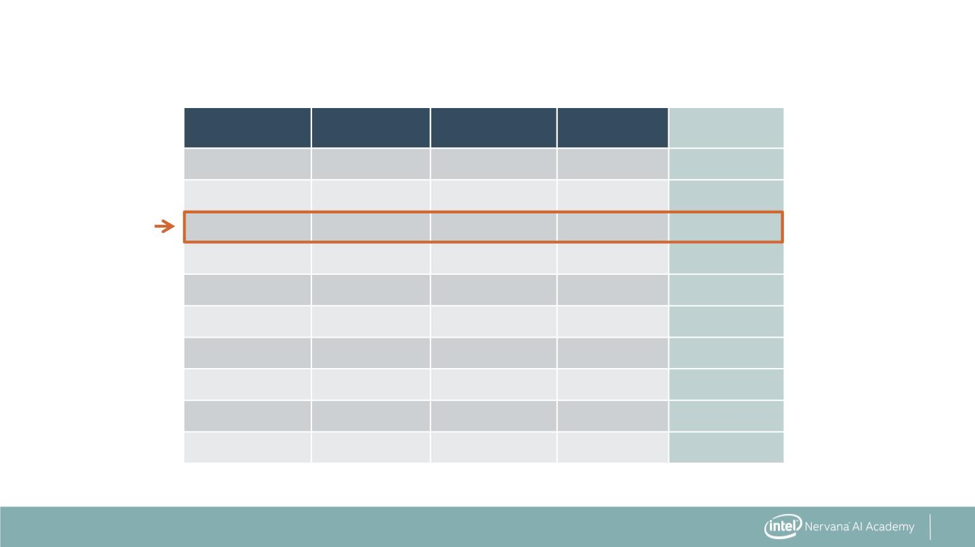
Machine Learning Vocabulary
Sepal length
Sepal width
Petal length
Petal width
Species
6.7
6.4
4.6
6.9
4.4
4.8
5.9
5.4
4.9
5.4
3.0
2.8
3.4
3.1
2.9
3.0
3.0
3.9
3.0
3.4
5.2
5.6
1.4
4.9
1.4
1.4
5.1
1.3
1.4
1.7
2.3
2.1
0.3
1.5
0.2
0.1
1.8
0.4
0.2
0.2
Virginica
Virginica
Setosa
Examples
Versicolor
Setosa
Setosa
Virginica
Setosa
Setosa
Setosa
22

Slide 23
Machine Learning Vocabulary
. Target: predicted category or value of the data
(column to predict)
. Features: properties of the data used for prediction
(non-target columns)
. Example: a single data point within the data
(one row)
. Label: the target value for a single data point
23

Slide 24
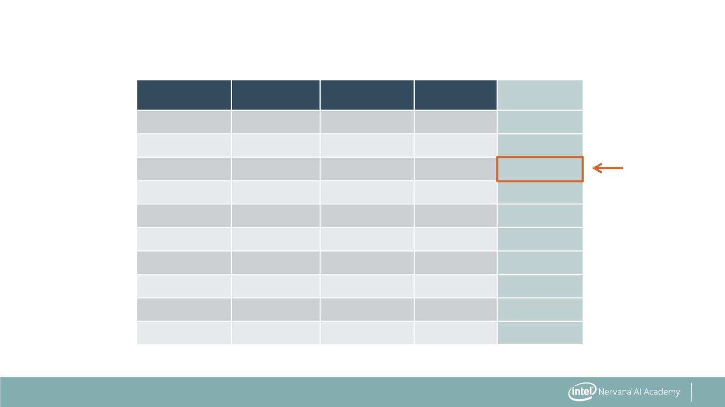
Machine Learning Vocabulary
Sepal length
Sepal width
Petal length
Petal width
Species
6.7
6.4
4.6
6.9
4.4
4.8
5.9
5.4
4.9
5.4
3.0
2.8
3.4
3.1
2.9
3.0
3.0
3.9
3.0
3.4
5.2
5.6
1.4
4.9
1.4
1.4
5.1
1.3
1.4
1.7
2.3
2.1
0.3
1.5
0.2
0.1
1.8
0.4
0.2
0.2
Virginica
Virginica
Setosa
Label
Versicolor
Setosa
Setosa
Virginica
Setosa
Setosa
Setosa
24

Slide 25


Slide 26

What is Classification?
A flower shop wants to
guess a customer's
purchase from similarity to
most recent purchase.
26

Slide 27

What is Classification?
Which flower is a
customer most likely to
purchase based on
similarity to previous
purchase?
?
27

Slide 28
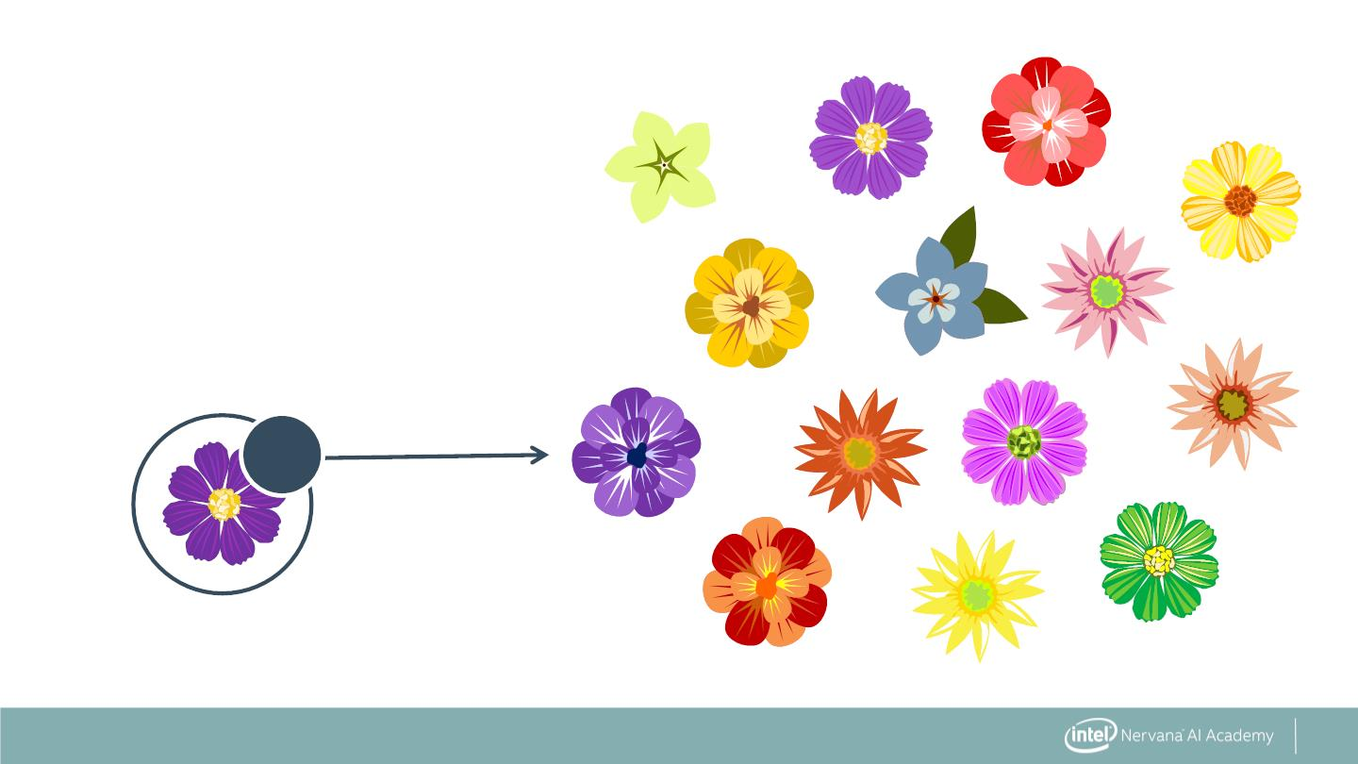
What is Classification?
Which flower is a
customer most likely to
purchase based on
similarity to previous
purchase?
?
28

Slide 29

What is Classification?
Which flower is a
customer most likely to
purchase based on
similarity to previous
purchase?
?
29

Slide 30
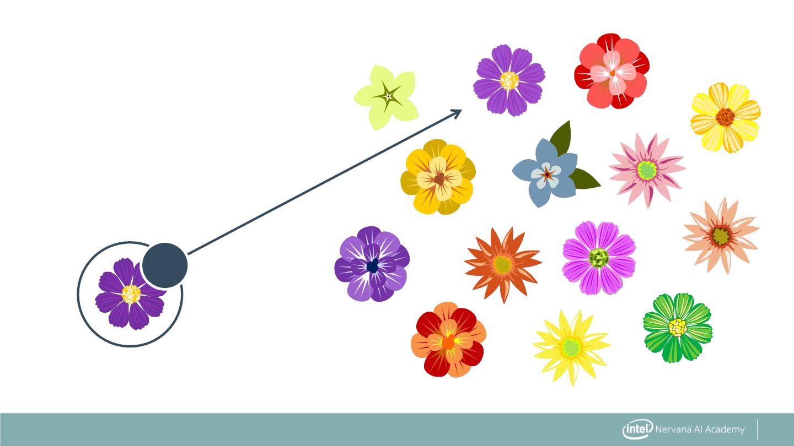
What is Classification?
Which flower is a
customer most likely to
purchase based on
similarity to previous
purchase?
?
30

Slide 31
What is Needed for Classification?
. Model data with:
. Features that can be quantitated
31

Slide 32
What is Needed for Classification?
. Model data with:
. Features that can be quantitated
. Labels that are known
32

Slide 33
What is Needed for Classification?
. Model data with:
. Features that can be quantitated
. Labels that are known
. Method to measure similarity
33

Slide 34
K Nearest Neighbors Classification
34

Slide 35
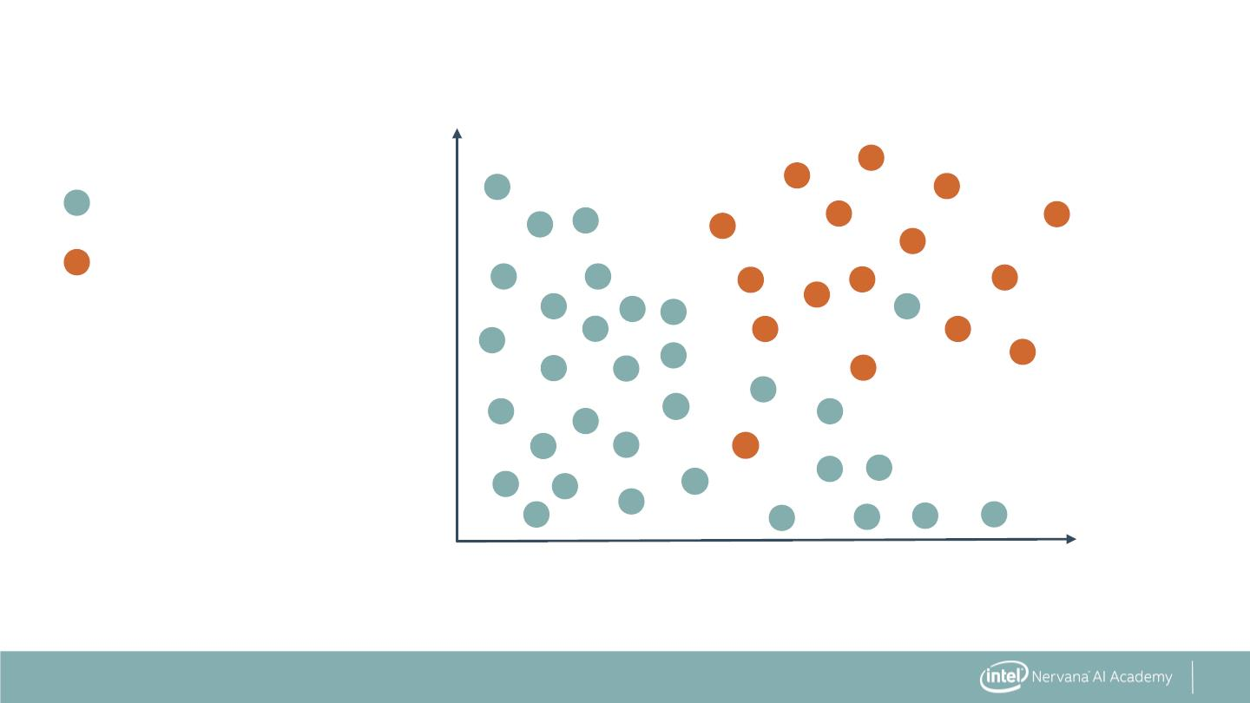
K Nearest Neighbors Classification
60
Survived
Did not survive
40
Age
20
0
10
20
Number of Malignant Nodes
35

Slide 36
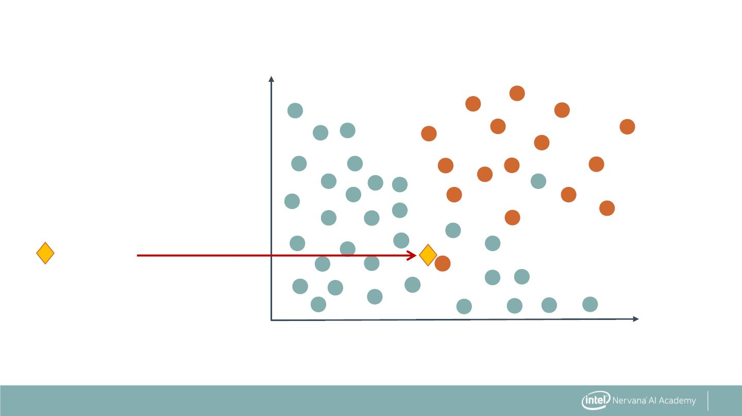
K Nearest Neighbors Classification
60
40
Age
Predict
20
0
10
20
Number of Malignant Nodes
36

Slide 37
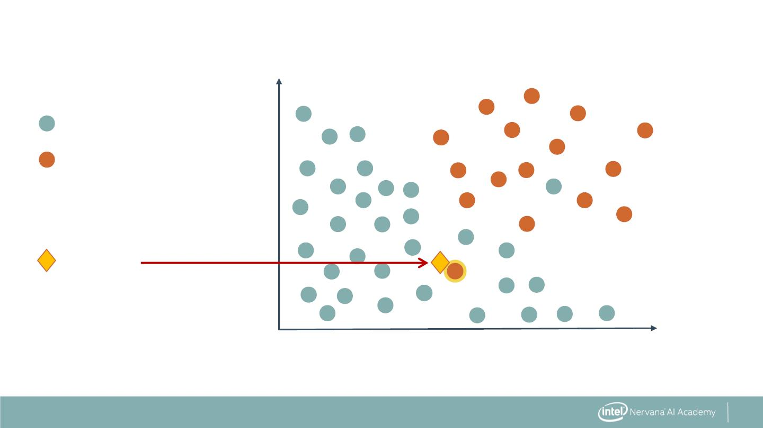
K Nearest Neighbors Classification
Neighbor Count (K = 1):
60
40
20
0
1
Age
Predict
0
10
20
Number of Malignant Nodes
37

Slide 38
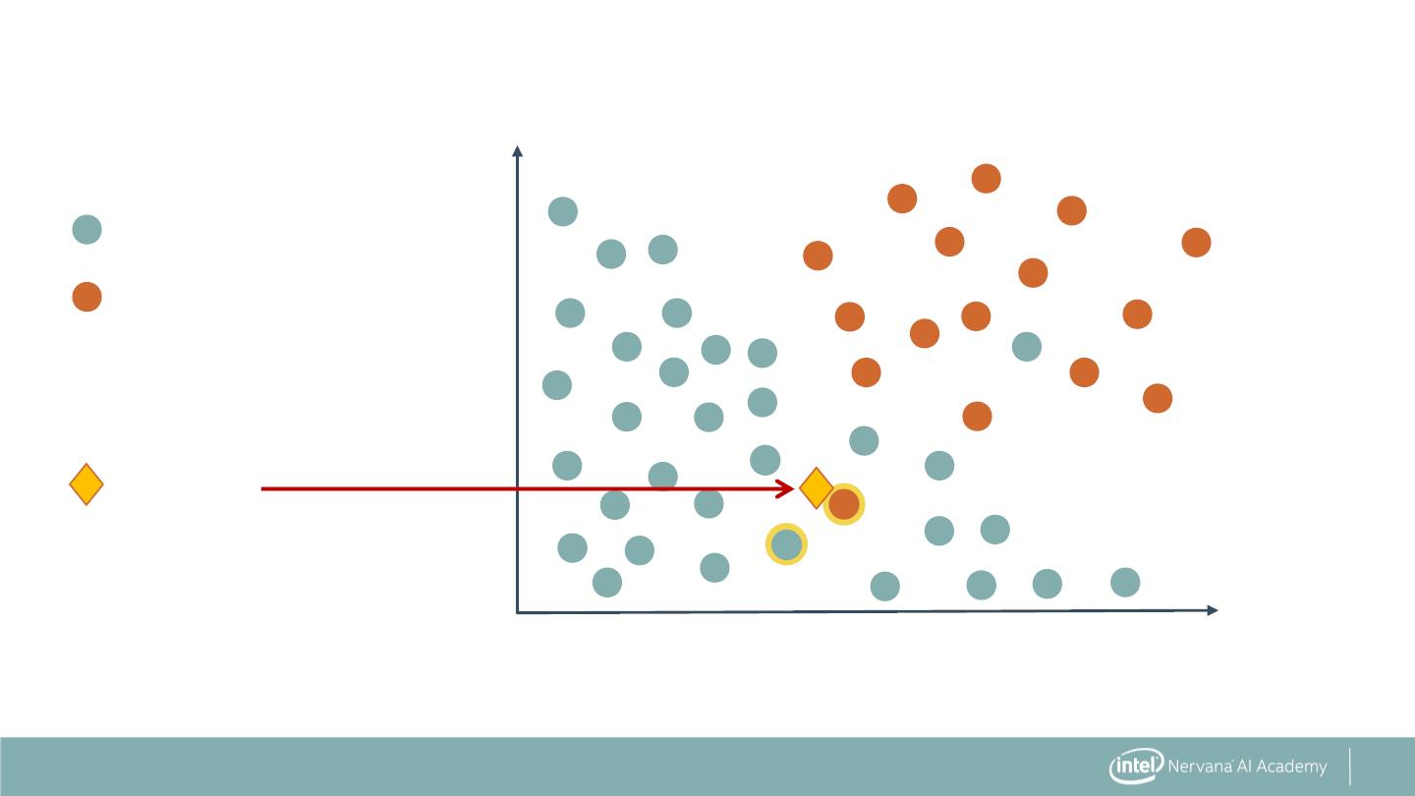
K Nearest Neighbors Classification
Neighbor Count (K = 2):
60
40
20
1
1
Age
Predict
0
10
20
Number of Malignant Nodes
38

Slide 39
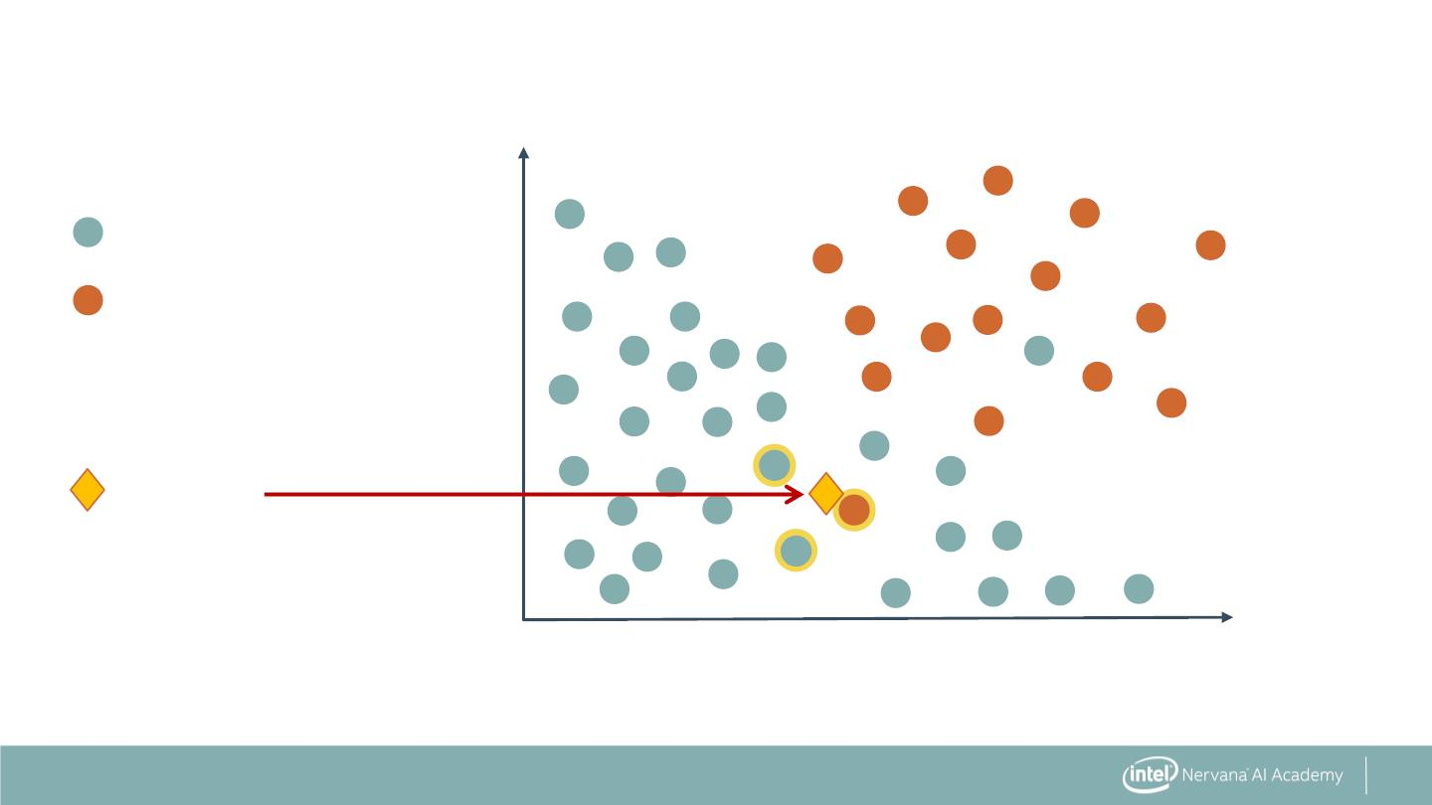
K Nearest Neighbors Classification
Neighbor Count (K = 3):
60
40
20
2
1
Age
Predict
0
10
20
Number of Malignant Nodes
39

Slide 40

K Nearest Neighbors Classification
Neighbor Count (K = 4):
60
40
20
3
1
Age
Predict
0
10
20
Number of Malignant Nodes
40

Slide 41
What is Needed to Select a KNN Model?
41

Slide 42
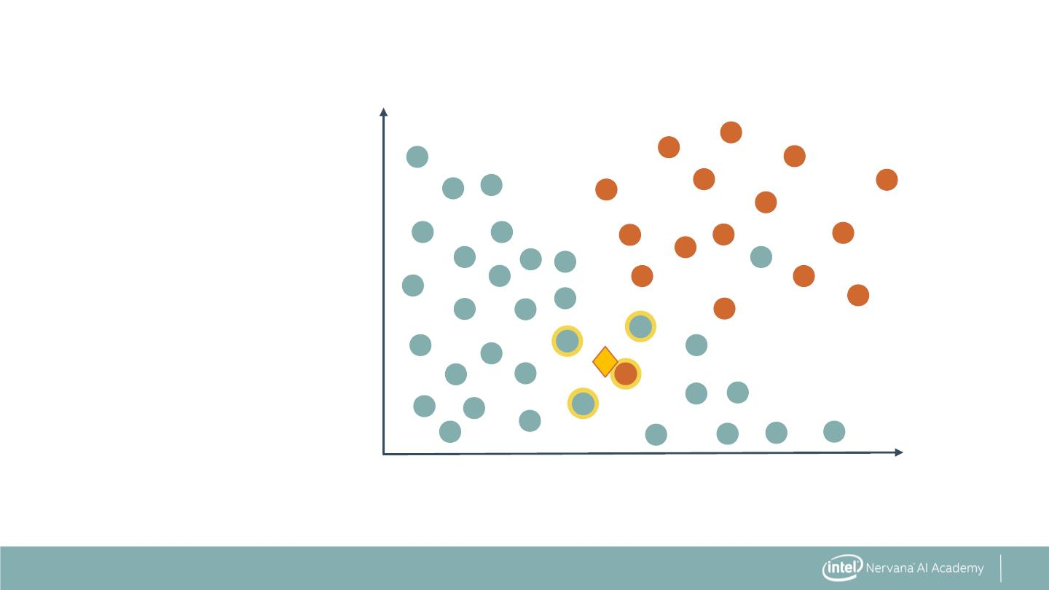
What is Needed to Select a KNN Model?
. Correct value for 'K'
60
40
20
. How to measure
closeness of
neighbors?
Age
0
10
20
Number of Malignant Nodes
42

Slide 43
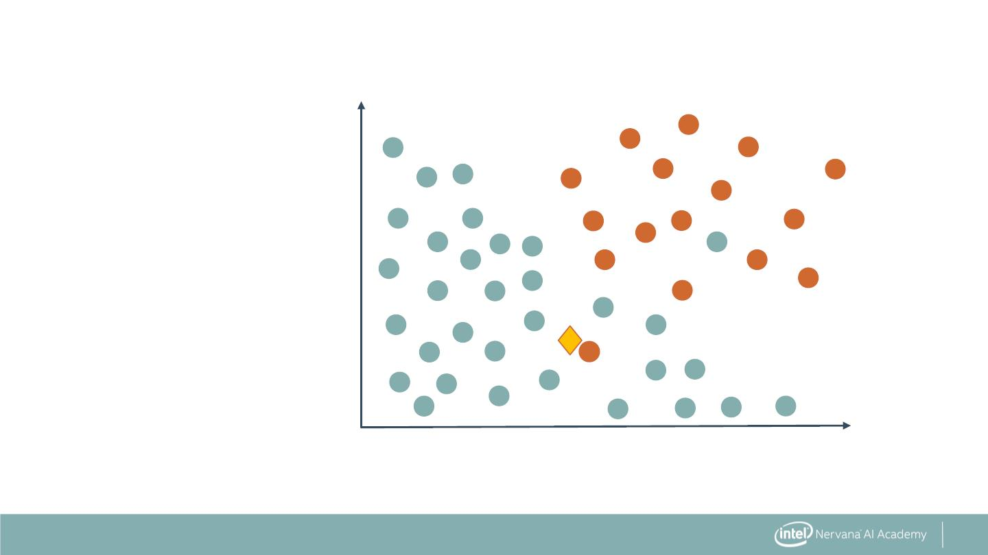
Measurement of Distance in KNN
60
40
Age
20
0
10
20
Number of Malignant Nodes
47

Slide 44

Measurement of Distance in KNN
60
40
Age
20
0
10
20
Number of Malignant Nodes
48

Slide 45
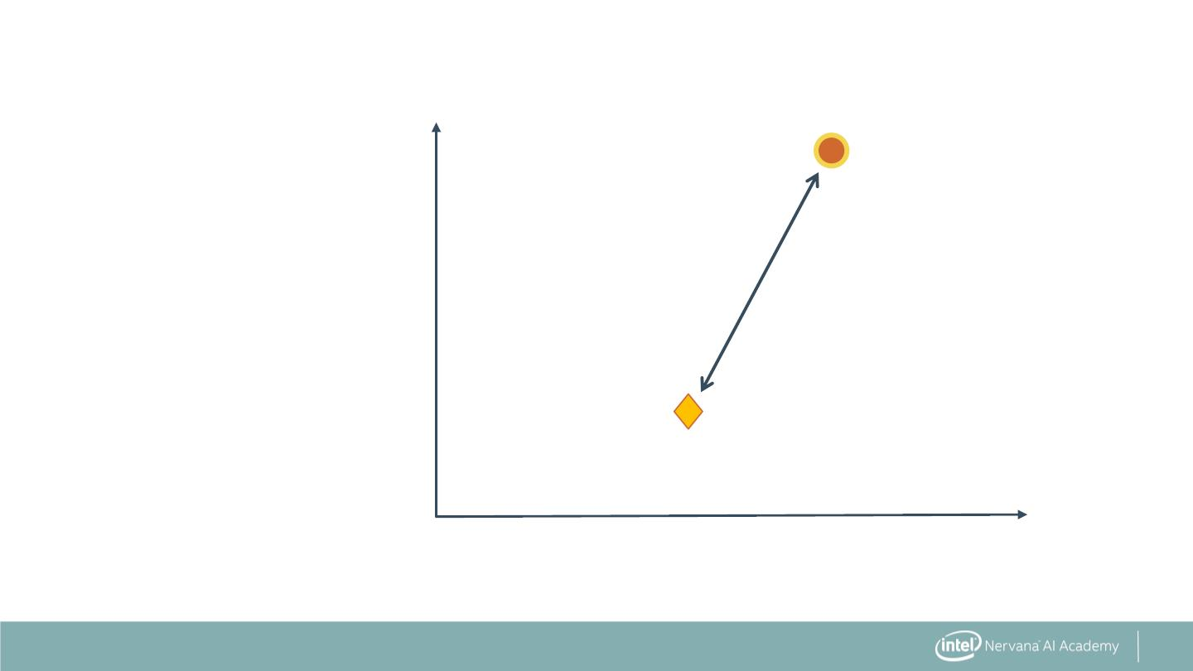
Euclidean Distance
60
40
20
Age
0
10
20
Number of Malignant Nodes
49

Slide 46
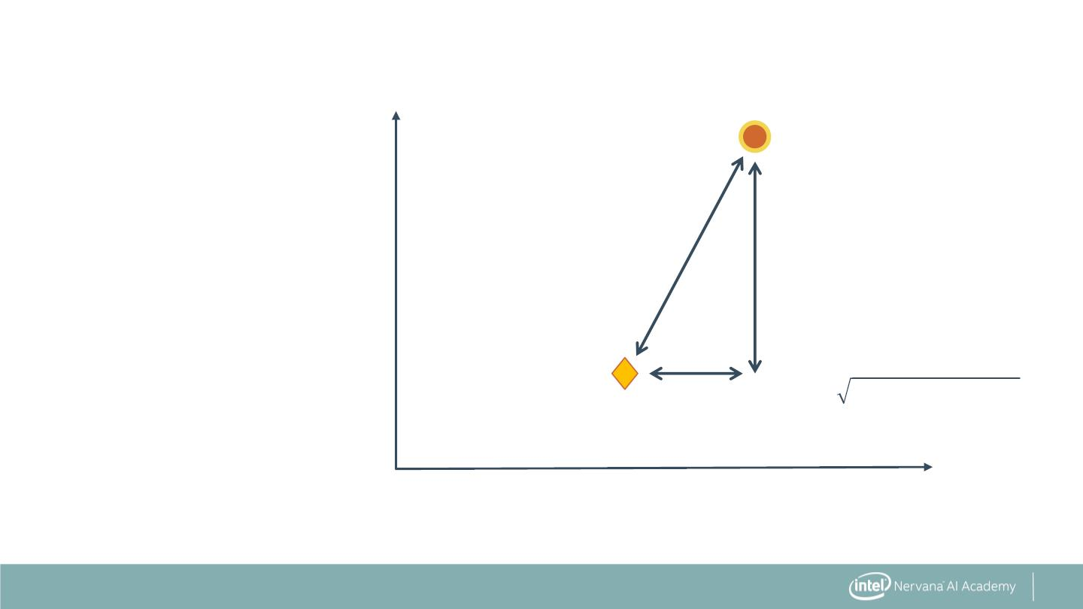
Euclidean Distance (L2 Distance)
60
d
40
∆ Age
Age
20
푑 = ∆푁표푑푒푠² + ∆퐴푔푒²
∆ Nodes
0
10
20
Number of Malignant Nodes
50

Slide 47
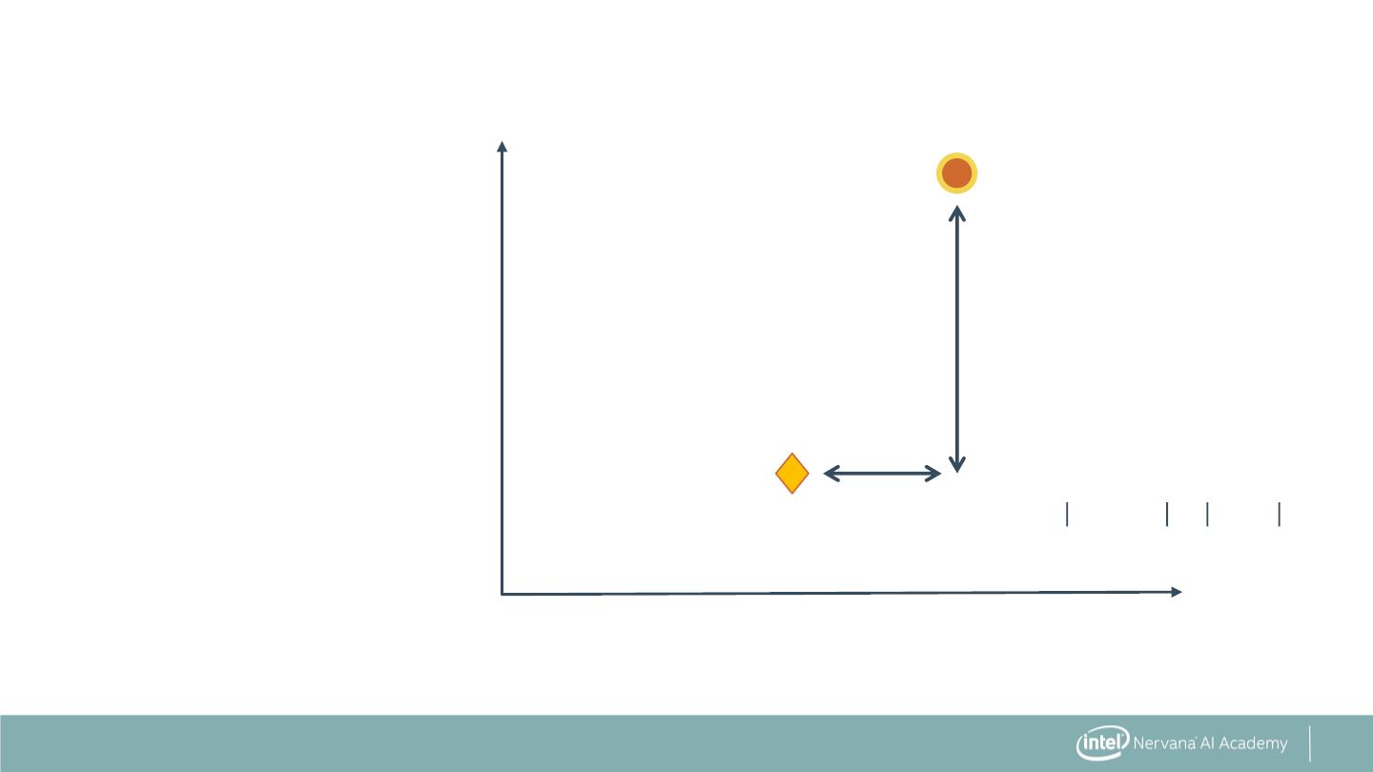
Manhattan Distance (L1 or City Block Distance)
60
40
∆ Age
Age
20
∆ Nodes
푑 = ∆푁표푑푒푠 + ∆퐴푔푒
0
10
20
Number of Malignant Nodes
51

Slide 48
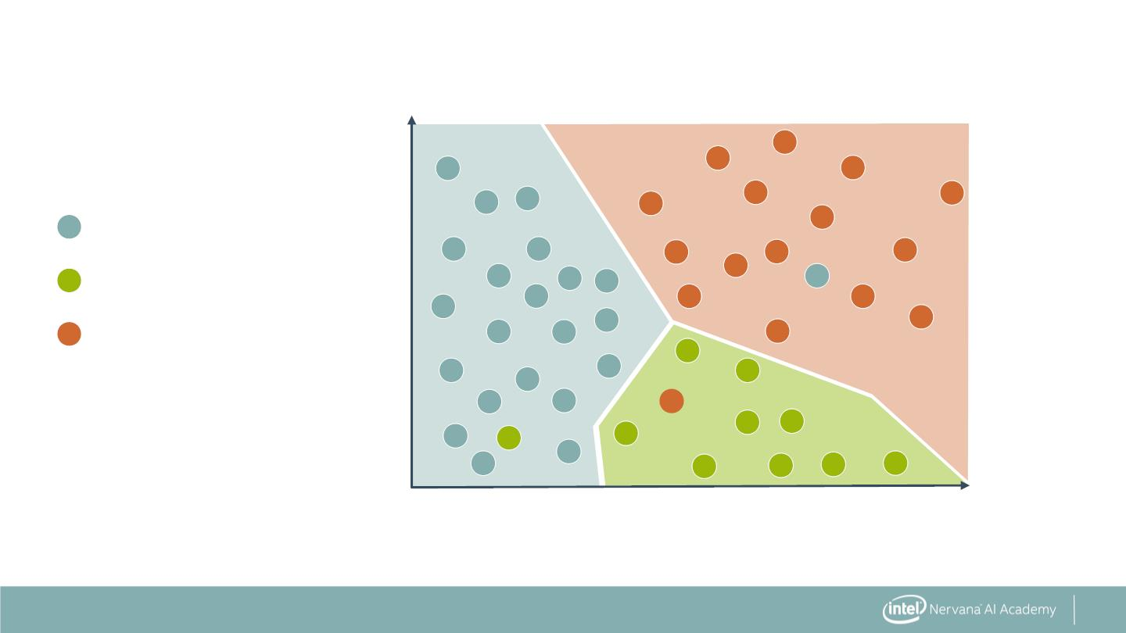
Multiclass KNN Decision Boundary
K=5
60
40
20
Full remission
Partial remission
Did not survive
Age
0
10
20
Number of Malignant Nodes
63

Slide 49
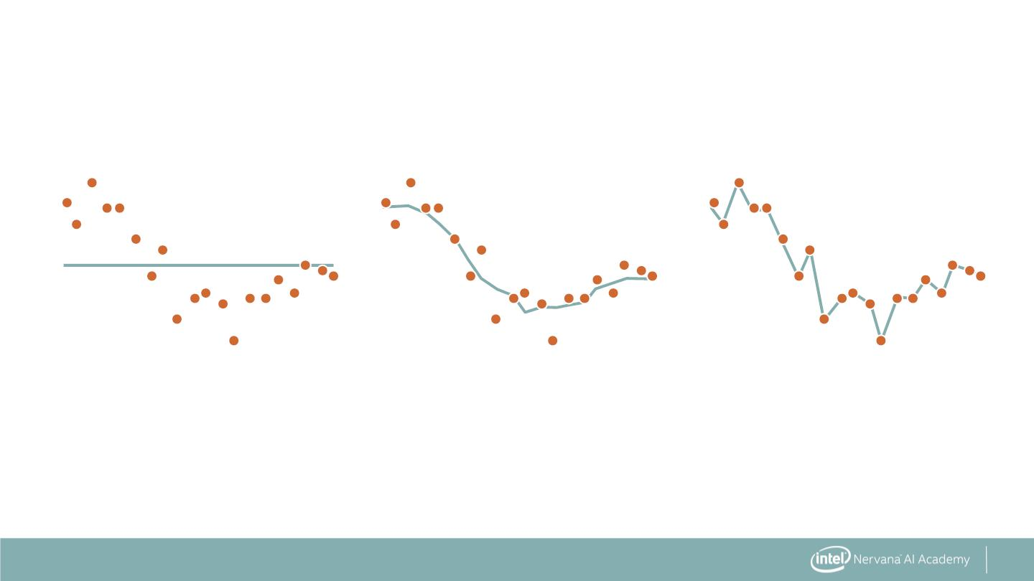
Regression with KNN
K = 20
K = 3
K = 1
64

Slide 50
Characteristics of a KNN Model
. Fast to create model because it simply stores data
. Slow to predict because many distance calculations
. Can require lots of memory if data set is large
65

Slide 51
K Nearest Neighbors: The Syntax
Import the class containing the classification method
from sklearn.neighbors import KNeighborsClassifier
66

Slide 52
K Nearest Neighbors: The Syntax
Import the class containing the classification method
from sklearn.neighbors import KNeighborsClassifier
Create an instance of the class
KNN = KNeighborsClassifier(n_neighbors=3)
67

Slide 53
K Nearest Neighbors: The Syntax
Import the class containing the classification method
from sklearn.neighbors import KNeighborsClassifier
Create an instance of the class
KNN = KNeighborsClassifier(n_neighbors=3)
Fit the instance on the data and then predict the expected value
KNN = KNN.fit(X_data, y_data)
y_predict = KNN.predict(X_data)
68

Slide 54
K Nearest Neighbors: The Syntax
Import the class containing the classification method
from sklearn.neighbors import KNeighborsClassifier
Create an instance of the class
KNN = KNeighborsClassifier(n_neighbors=3)
Fit the instance on the data and then predict the expected value
KNN = KNN.fit(X_data, y_data)
y_predict = KNN.predict(X_data)
69

Slide 55
K Nearest Neighbors: The Syntax
Import the class containing the classification method
from sklearn.neighbors import KNeighborsClassifier
Create an instance of the class
KNN = KNeighborsClassifier(n_neighbors=3)
Fit the instance on the data and then predict the expected value
KNN = KNN.fit(X_data, y_data)
y_predict = KNN.predict(X_data)
Regression can be done with KNeighborsRegressor.
70

Slide 56
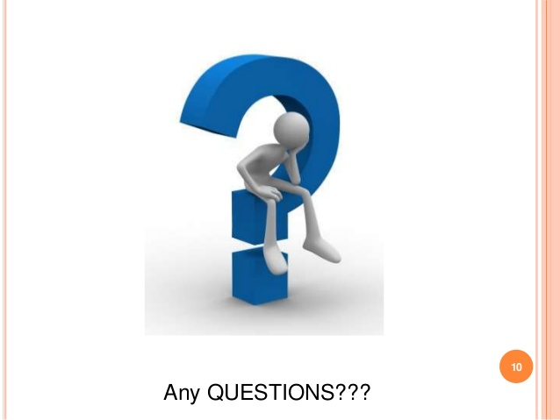

Slide 57


